Slide 1
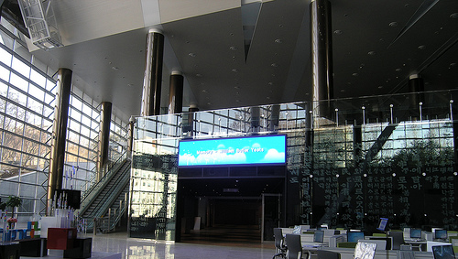



Adopting MOOCs for Credit Transfer -
A Step by Step Guide…
Dr(Mrs) Pankaj Mittal
Additional Secretary, University Grants Commission
(Former Vice Chancellor, BPS Women University, Haryana )
Vigyan Bhawan, July 9, 2017

Slide 2
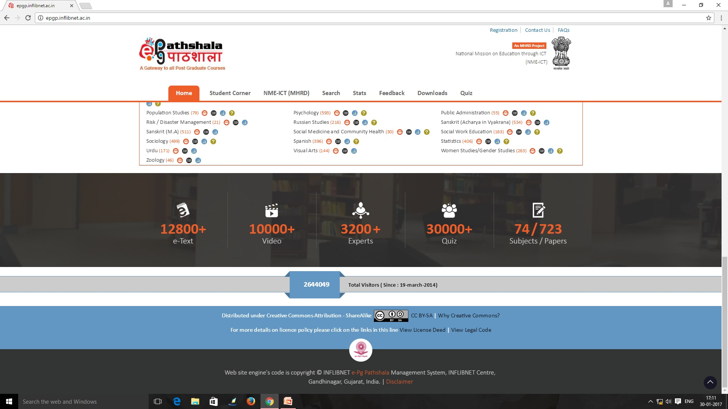
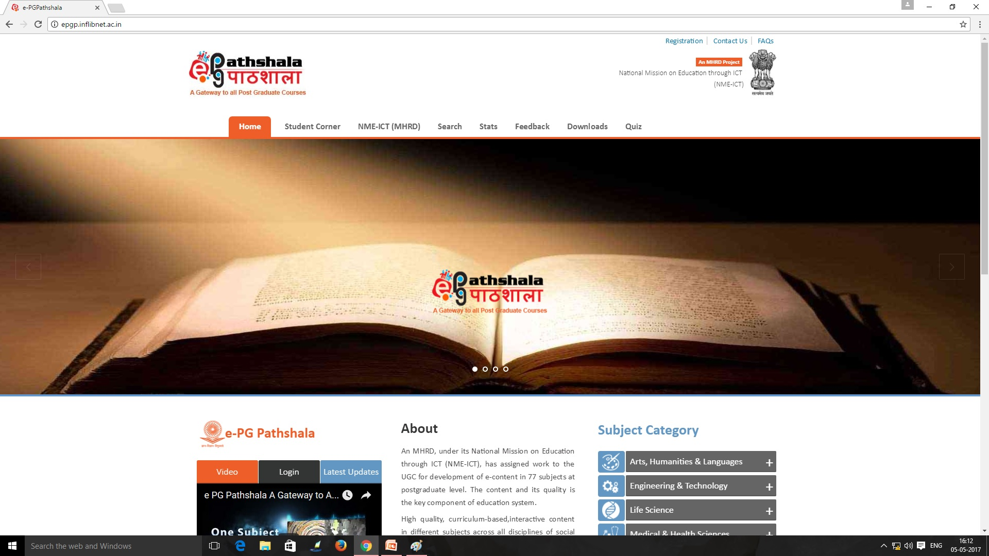

Slide 3
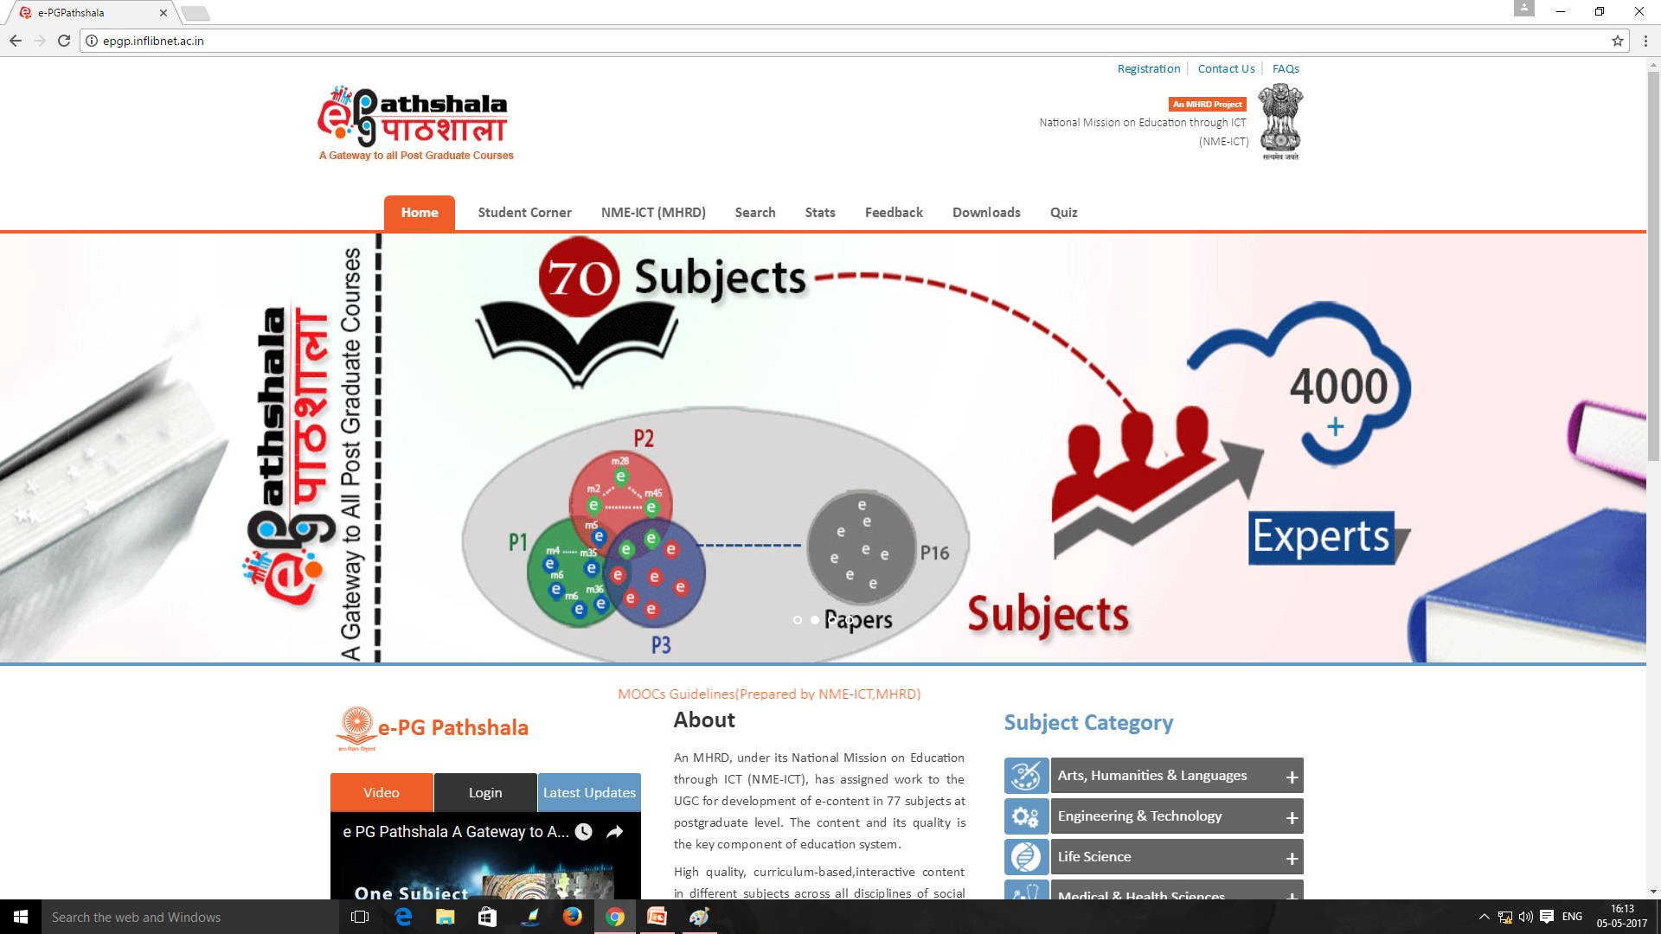
35,000 modules

Slide 4
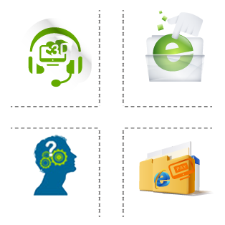

Present Status of e-PG Pathshala
Videos/e-text available on e-PG Pathshala website
13,000+
Visitors on e-PG Pathshala (Globally)
29 lakh+
E-content of e-PG Pathshala used for MOOCs on SWAYAM and for telecasting educational videos on 10 DTH Channels under Swayam Prabha project

Slide 5
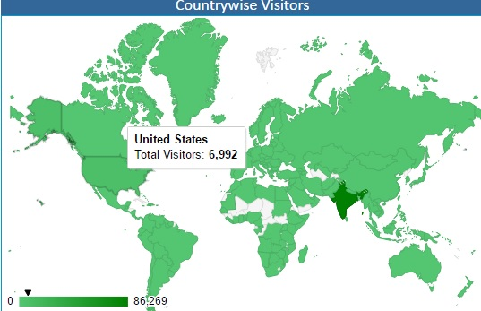
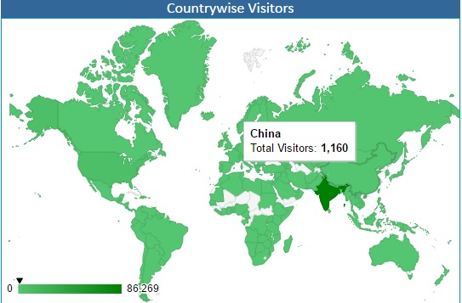
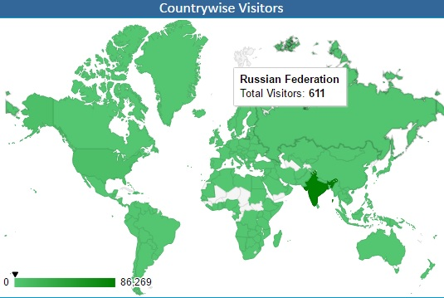
Impact Analysis of e-PG Pathshala
e- Content is available in open access at www.epgp.inflibnet.ac.in
International visitors – 6992+ from USA, 1030+ from China and 611+ from Russian federation)
Total visitors - 29 lakhs

Slide 6
MOOCs - A different educational space
Boundary less Institute / University
Massive- Large enrolment numbers
Open - No mandatory qualifications – Open to all
Online - Fully online
Course - Structured course content
is an online course aimed at unlimited participation and open access via the web.
The basic philosophy of MOOCs is 3A’s i.e., Anytime, Anyone, Anywhere.
UGC – National Coordinator for Non technology PG Courses

Slide 7
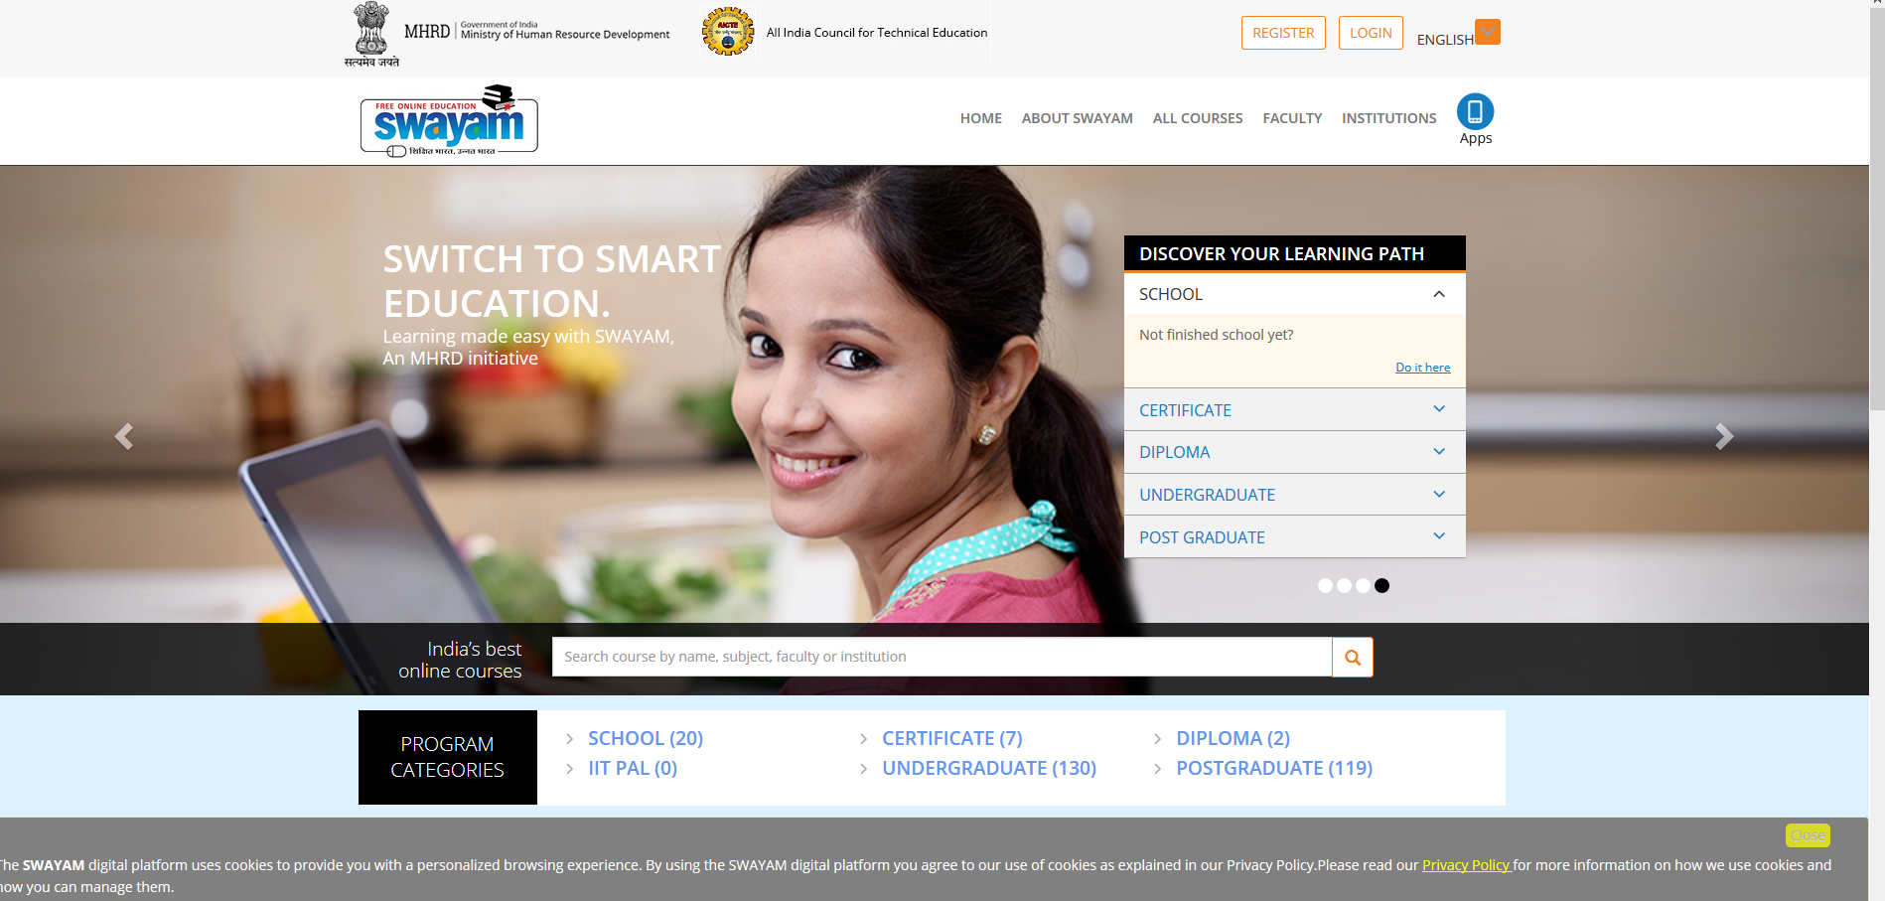

Slide 8
e-Content vs MOOCs
E-PG Pathshala
(OER)
MOOCs
E-PG Pathshala provides e-content in four quadrants. It can be accessed as Open Educational Resource (OER) where no teacher support/hand-holding for students is available.
MOOCs has teacher-student groups where MOOC coordinator/teacher interacts with the learner. A learner can earn certificate/credit on successful completion of MOOCs course on SWAYAM.

Slide 9
Development of MOOCs
Two methods followed:
  Repurposed from e PGP (63 uploaded on Swayam, 100 in pipe-line)
  New MOOCs to be developed (100 in first year)
New MOOCs may be offered for - courses high in demand but expertise not available in majority of the universities (eg Electives). Suggestions invited- academia, students, industry on UGC Website
For core and generic papers, e-PG Pathshala to be used as OER

Slide 10



UGC (Credit Framework for Online Learning Courses through SWAYAM) Regulation, 2016
Issued on 19th July 2016
Learning Courses
Notification
Online learning courses to be available on SWAYAM
SWAYAM to notify courses on June 1 & Nov 1, every year
Credit Transfer
Choice of Courses
Up to 20% courses in a Program can be on SWAYAM
Courses on SWAYAM permitted for credit transfer

Slide 11
Step by step procedure to be adopted by Universities for adopting MOOCs on SWAYAM
Step-1: Make Amendments
The University through their Competent Authority (EC, AC, BOS), should make amendments in their Ordinances, Rules, Regulations to incorporate provisions for transfer of credits for MOOCs courses as per UGC Regulations.
Step-2: Select the Courses
The University shall select the courses to be permitted for credit transfer through SWAYAM. (eg courses in high demand for which faculty is not available, elective courses or for supplementing teaching-learning process) while ensuring that physical facilities like laboratories, computer facilities, library etc. required for the course are made available free to the students in adequate measure
Step-3: Designate Course Coordinator
The University must designate a Course Coordinator/facilitator to guide the students throughout the course and to facilitate/conduct the Lab/Practical sessions/examinations.
Step-4: Disseminate Information
The University should widely disseminate information about selected courses and motivate the students through faculty members, notice boards, student forums, workshops and university website etc.

Slide 12
Steps Continued…
Step-5: Course Registration
University to facilitate registration of students. Every student enrolled for the course in the University must register for the MOOCs course.
Step-6: Evaluation
The Host Institution shall evaluate the students registered for MOOCs courses based on discussion forums, quizzes, assignments, sessional and final examinations. The University to assist Host Institution in conducting the final examination.
Step-7: Marks of the Students
The University shall incorporate the marks/grades communicated by the Host Institution in the final mark sheet of the student which counts for award of degree/diploma. However, the University shall evaluate the students for the practical/lab component and incorporate these marks/grades in the overall mark sheet of the student.
Step-8: Certificate
On receipt of MOOCs completion certificate from Host Institute, the University to give equivalent credit weight (up to 20%) for the credits earned through SWAYAM. No University shall refuse any student for credit mobility for courses earned through MOOCs.

Slide 13
Our Journey…..
SWAYAM (MOOCs), e PGP
& SWAYAM PRABHA (DTH Channels)
Content delivery & MOOCs initiated
Guidelines developed
PIs identified
Project awarded
Content Creation in four quadrants
Born
(2011)
Bigger
2016-Mid
2017
Growth
2012
Stronger
2013-15

Slide 14
Outcome of the Project
Addresses the problem of Access, Equity and Quality by addressing faculty shortage and lack of good quality faculty.
The project would help the students and teachers to update their knowledge and skills, especially for those located in rural/backward/remote areas.
The project would successfully bridge the digital divide and would help the nation move towards information-rich society.

Slide 15
Thanks for patient hearing
pankajugc@gmail.com

